Slide 1



Classification, Reserve & RQO determination of water resources in the Mvoti to Umzimkulu Water Management Area
ECONOMIC CONSEQUENCES: APPROACH AND RESULTS
William Mullins
Conningarth Economists
16 September 2015
PRESENTATION TITLE
Presented by:
Name Surname
Directorate
Date

Slide 2
Structure of Presentation
Where do economics fit in to the decision making?
What approach has been followed?
Specific approach in this section
Results of the different options

Slide 3
Any decision on water has an impact on the economic and socio-economic situation of the immediate surroundings.
It involves:
The current situation; and
The future situation

Slide 4
Why GDP and Employment as parameters?
GDP is the universal accepted parameter to measure economic growth (impact).
Gross domestic product (GDP) is defined as "an aggregate measure of production equal to the sum of the gross values added of all resident, institutional units engaged in production (plus any taxes, and minus any subsidies, on products not included in the value of their outputs)
GDP estimates are commonly used to measure the economic performance of a whole country or region, but can also measure the relative contribution of an industry sector
Employment is an indicator of the socio-economic impact of any scenario

Slide 5
Methodology based on CBA principles
Methodology for baseline based on CBA principles
Status quo – Volume of water
Status quo – Value of water in GDP
Growth on status quo
Status quo – Employment
Apply value of water on growth volume
Discount according to CBA principles
Apply employment on growth volume
Projected additional employment
Projected GDP growth

Slide 6
Results of uMngeni Catchment
Results of the operational scenarios in the uMngeni Catchment:
Sc | Additional allocation (million m³/a) | Projected GDP growth (R million) | Projected additional labour | URV (R/m³) | URV (Number/mm³)
UM41 | 142.2 | R 13 927 | 208 611 | R15.95 | 239
UM51 | 205 | R 11 942 | 232 725 | R10.73 | 209

Slide 7
Results of Lovu Catchment
Results of the operational scenarios in the Lovu Catchment
Sc | Reduction in forestry water volume (mm³/a) | Projected GDP growth (R million) | Projected additional labour
LO3 | 2.65 | R -388 | -4 156
LO4 | 5.30 | R -775 | -8 312

Slide 8
Methodology followed to estimate the socio-economic impact
Waste water management options are an building block in the final classification process.
Certain decisions are already in place when these are investigated in terms of the best overall scenarios.
These scenarios are investigated as ad on to the already taken decisions.

Slide 9
Waste Water Options Implementation
The Capital and Operational Costs of all of the Waste Water Options (on next slide) were implemented in the Cost Benefit Analysis on the applicable timescale and discounted to a comparable value, the Net Present Value, for the two metrics GDP and employment
Scenarios breakdown:
  A Scenarios: Ecological Protection is priority
  B Scenarios: Highest discharge into estuaries
  C & D Scenarios: Capital expenditure time delay
  E & F Scenarios: Indirect reuse & Direct reuse
Note the high costs of the reuse options

Slide 10
Scenario | Description | CAPEX (R Million) | OPEX (R Million)
Scenario Ai | Ecological Protection Priority | 7 069.80 | 551.83
Scenario Aii | Fall Back option for Scenario Ai | 7 476.83 | 453.00
Scenario Aiii | As in Ai but WW plants to capacity | 6 921.73 | 582.35
Scenario Bi | Highest discharge into estuaries | 6 873.80 | 810.69
Scenario Bii | Scenario Bi with alternative | 7 336.54 | 753.38
Scenario C | 5 year plan | 6 727.96 | 626.10
Scenario D | 10 year plan | 6 409.62 | 688.29
Scenario E | Indirect reuse | 8 372.07 | 710.73
Scenario F | Direct reuse | 14 063.28 | 1 319.28
Scenario Biii | Highest discharge into estuaries | 5 400.41 | 191.46
Scenario Aiv | Ecological Protection Priority | 7 338.59 | 602.68
Scenario Av | Alternative of Scenario A | 7 178.33 | 454.60
Scenario Ci | 5 year plan | 6 134.07 | 322.83
Scenario Di | 10 year plan | 5 667.25 | 338.52

Slide 11
Methodology based on CBA principles
Waste Water Options integration in Cost Benefit Analysis:
Baseline NPV
Various CAPEX and OPEX of option combined on applicable timescale
Waste Water Option Scenarios Costs
Capex and Opex: Macro-economic impact derived from Social Accounting Matrix
Capex and Opex: Impact on NPV Positive
Capex and Opex: Opportunity cost of diverted funds from alternative projects
Cost of investment: Impact on NPV negative
Waste Water Options NPV

Slide 12
Approach to Analyse Scenarios E and F
Show Exchange at Smithfield Dam
Show capital used
Benefit Calculation
Net Present Value = PV benefits – PV costs

Slide 13
Approach to Analyse Scenarios E and F
Smithfield
Total cost
Reuse
Hypothetical cost benefit from reuse
2040

Slide 14
Another look at Scenarios E and F – Re-use options
Discounted Cost Item | Scenario E Rand Million | Scenario F Rand Million
Capital Costs - Waste Water | R 12 088.63 | R 13 441.63
Capital Costs – Smithfield & Ngwadini | R 13 526.86 | R 5 556.30
Opex - Waste Water – 39 years | R 41 122.22 | R 53 283.63
Opex – Smithfield – 39 Years | R 1 553.65 | R 1 553.65
Total | R 68 291.36 | R 73 835.21
Ranking GDP | 11 | 1
Ranking Employment | 10 | 2
Ranking Capital Costs | 4 | 1
Ranking Operational Costs | 2 | 1

Slide 15
Results
Net Present Value is an inverse function of the capital and operational costs of the Waste Water Options
The Scenarios were ranked by highest to lowest Net Present Value
Ranking is based on the highest net benefit to society in terms of GDP and employment stimulation

Slide 16
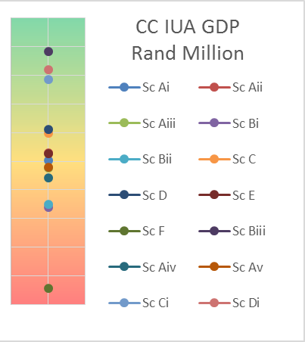
Results CC IUA GDP
Scenario Biii (Highest Discharge) yields the highest NPV because of its low cost
Scenarios C, D, Ci and Di (5 year & 10 year plans) has higher NPVs than the remaining options since discounting a delayed cost yields a higher value
The remaining scenarios with all their respective capital and operational costs taken into consideration with the related NPVs
Scenario F (Indirect & Direct reuse) yields the lowest NPV because of its high cost. Despite the direct reuse benefit, this option still ranks the lowest since the cost exceeds the benefit in the discounted Cost Benefit Model

Slide 17
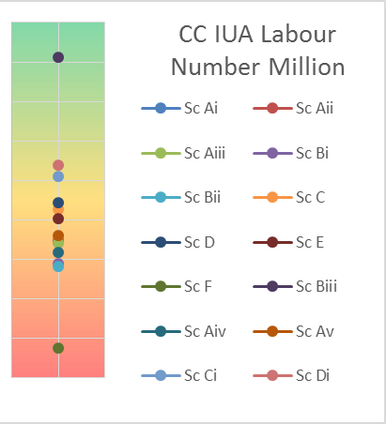
Results CC IUA Employment
Scenario Biii (Highest Discharge) yields the highest NPV because of its low cost
Scenarios C, D, Ci and Di (5 year & 10 year plans) has higher NPVs than the remaining options since discounting a delayed cost yields a higher value
The remaining scenarios with all their respective capital and operational costs taken into consideration with the related NPVs
Scenario F (Indirect & Direct reuse) yields the lowest NPV because of its high cost. Despite the direct reuse benefit, this option still ranks the lowest since the cost exceeds the benefit in the discounted Cost Benefit Model

Slide 18
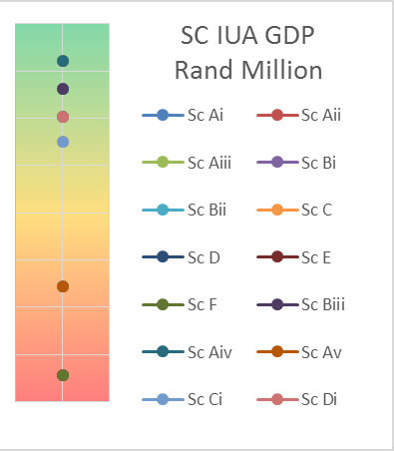
Results SC IUA GDP
Scenario Aii, Aiii, Aiv (WW at capacity) yields the highest NPV because of its low cost
Scenarios Bi, Bii, Biii (Highest discharge into estuaries) yields the second highest set of NPVs
Scenario D, Di (10 year plan) yields the third highest NPV
Scenario C, Ci (5 year plan) yields the fourth highest NPV
Scenario Ai, Av (Ecological protection is priority) yields the fifth highest NPV
Scenario E,F (Indirect & Direct reuse) yields the lowest NPV because of its high cost. Despite the direct reuse benefit, these options still ranks the lowest since the cost exceeds the benefit in the discounted Cost Benefit Model

Slide 19
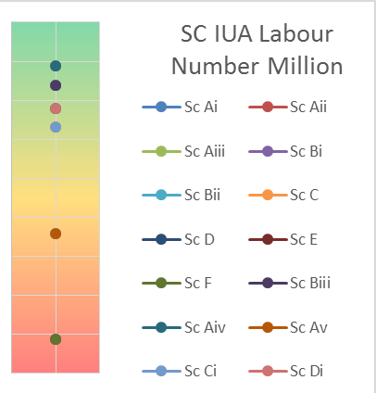
Results SC IUA Employment
Scenario Aii, Aiii, Aiv (WW at capacity) yields the highest NPV because of its low cost
Scenarios Bi, Bii, Biii (Highest discharge into estuaries) yields the second highest set of NPVs
Scenario D, Di (10 year plan) yields the third highest NPV
Scenario C, Ci (5 year plan) yields the fourth highest NPV
Scenario Ai, Av (Ecological protection is priority) yields the fifth highest NPV
Scenario E,F (Indirect & Direct reuse) yields the lowest NPV because of its high cost. Despite the direct reuse benefit, these options still ranks the lowest since the cost exceeds the benefit in the discounted Cost Benefit Model

Slide 20
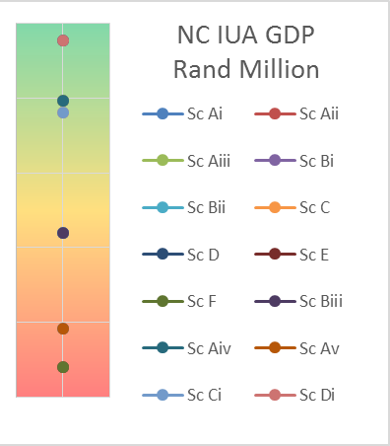
Results NC IUA GDP
Scenario D, Di (10 year plan) yields the highest NPV because of its low cost
Scenarios Aii, Aiii, Aiv (WW plants to capacity) yields the second highest set of NPVs
Scenario C, Ci (5 year plan) yields the third highest NPV
Scenario Bi, Bii, Biii (Highest discharge into estuaries) yields the fourth highest NPV
Scenario Ai, Av (Ecological protection is priority) yields the fifth highest NPV
Scenario E,F (Indirect & Direct reuse) yields the lowest NPV because of its high cost. Despite the direct reuse benefit, these options still ranks the lowest since the cost exceeds the benefit in the discounted Cost Benefit Model

Slide 21
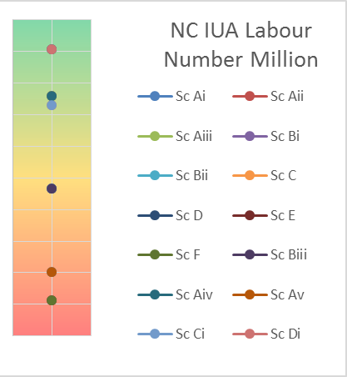
Results NC IUA Employment
Scenario D, Di (10 year plan) yields the highest NPV because of its low cost
Scenarios Aii, Aiii, Aiv (WW plants to capacity) yields the second highest set of NPVs
Scenario C, Ci (5 year plan) yields the third highest NPV
Scenario Bi, Bii, Biii (Highest discharge into estuaries) yields the fourth highest NPV
Scenario Ai, Av (Ecological protection is priority) yields the fifth highest NPV
Scenario E,F (Indirect & Direct reuse) yields the lowest NPV because of its high cost. Despite the direct reuse benefit, these options still ranks the lowest since the cost exceeds the benefit in the discounted Cost Benefit Model

Slide 22
Questions?

Slide 23
Thank you

